Slide 1

THE MAHARAJA SAYAJIRAO UNIVERSITY OF BARODA
COLLEGE PROJECT EVALUATION
Obesity &
Lifestyle EDA
सत्यं शिवं सुन्दरस्
Course : F.Y.BCA Semester 1 (Div A)
Group No: 05
Roll No : 36,22,93,24,25,108,113,102
Dataset : Obesity & Lifestyle EDA
Submission Date: 5th october 2026
OBESITY & LIFESTYLE EDA | FY.BCA.SEM1 (DIV-A) | MSU Vadodara
01/22

Slide 2
Introduction & Objective
Obesity is a complex, multifactorial chronic disease recognized globally as a major contributor to metabolic syndrome, cardiovascular disease, type 2 diabetes, and shortened life expectancy. While traditional epidemiological models reduce weight gain to an arithmetic imbalance of calories consumed versus calories expended, clinical and behavioral realities demonstrate that weight regulation is mediated by complex interactions between genetics, dietary composition, physical mobility, daily habits, and environmental infrastructure.
The primary objective of this project is to perform an exhaustive **Exploratory Data Analysis (EDA)** on the Obesity and Lifestyle dataset to uncover:
1. The structural distributions of eating habits, physical condition, and demographic attributes across weight tiers.
2. Direct bivariate and rank-order correlations linking behavioral habits to clinical weight levels (`NObeyesdad`).
3. **Hidden relationships, paradoxes, and confounding interactions** (such as the meal-skipping paradox, the family history buffering effect, and commute mode catalysis) that are masked by simple linear models.
4. Actionable feature-engineering insights to guide subsequent machine learning classification models.
OBESITY & LIFESTYLE EDA | FY.BCA.SEM1 (DIV-A) | MSU Vadodara
02/22

Slide 3
Data types and variables
ANALYSIS VARIABLES
NUMERICAL
Age · Height · Weight
CATEGORICAL
Transport · meal habits
BEHAVIORAL
Activity · screen time
GENETIC / FAMILY
Family history
DEMOGRAPHIC
Sex · age context
TARGET
7 obesity classes
OBESITY & LIFESTYLE EDA | FY.BCA.SEM1 (DIV-A) | MSU Vadodara
03/22

Slide 4
WEIGHT CLASSES
GENDER
FAMILY HISTORY
HIGH-CAL FOOD
balanced core; severe tail visible
near-even split
yes dominates
frequent is common
SNACKING
ACTIVITY
TECH TIME
COMMUTE
sometimes dominates
low-to-moderate center
mostly low / medium
public transport leads
OBESITY & LIFESTYLE EDA | FY.BCA.SEM1 (DIV-A) | MSU Vadodara
04/22

Slide 5
Dataset at a glance
2,111
16
7
3
observations
predictors
ordered weight classes
source countries
BODY
EATING
ACTIVITY
CONTEXT
Age • height • weight
FAVC • meals • snacking • water
PA frequency • technology time
Family history • gender • transport
Data quality & integrity
24
100%
14–61
duplicate records detected
WARNING Duplicate rows can inflate apparent certainty and leak across train/test splits. Deduplicate before inferential or predictive work.
field completeness
observed age range
OBESITY & LIFESTYLE EDA | FY.BCA.SEM1 (DIV-A) | MSU Vadodara
05/22

Slide 6
Data quality assessment
CHECK
CHECK
CHECK
Missing values
Duplicate rows
Type consistency
0 across all 15 columns
Checked and removed
float64 (numerical), object (categorical)
CHECK
CHECK
CHECK
Category spelling
Range / outliers
Target balance
Dataset is pre-cleaned (ObesityDataSet_cleaned.csv)
Duplicate detection & removal applied
Column names and formatting verified
OBESITY & LIFESTYLE EDA | FY.BCA.SEM1 (DIV-A) | MSU Vadodara
06/22

Slide 7
Python analytics stack
Python
Pandas
NumPy
Plotnine
SciPy
orchestration
cleaning + grouping
numeric operations
grammar-of-graphics
statistical checks
OBESITY & LIFESTYLE EDA | FY.BCA.SEM1 (DIV-A) | MSU Vadodara
07/22

Slide 8
Describe first. Explain second.
NUMERICAL
CATEGORICAL
Center · spread · shape
Count · share · balance
Age, height, weight and continuous lifestyle measures establish scale, skew and potential outliers.
Behavior, transport and family-history frequencies reveal dominant levels and sparse groups.
OBESITY & LIFESTYLE EDA | FY.BCA.SEM1 (DIV-A) | MSU Vadodara
08/22

Slide 9
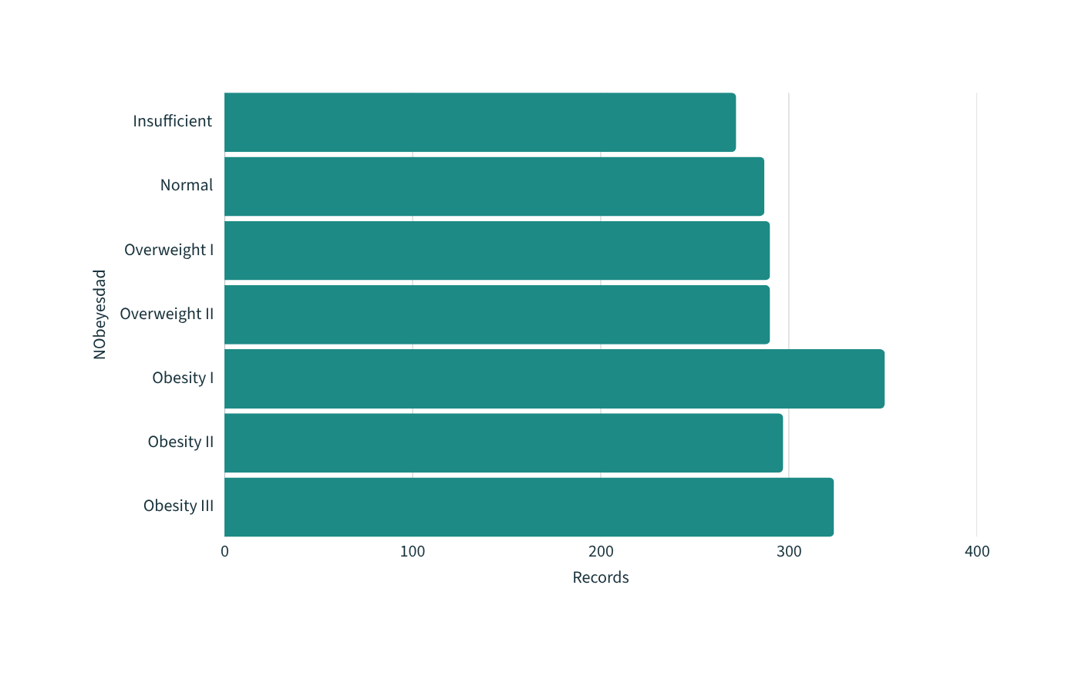
Weight-class landscape
46%
in obesity tiers
The ordered target is not binary. Preserve its seven-tier structure—and inspect class-level error, not accuracy alone.
OBESITY & LIFESTYLE EDA | FY.BCA.SEM1 (DIV-A) | MSU Vadodara
09/22

Slide 10
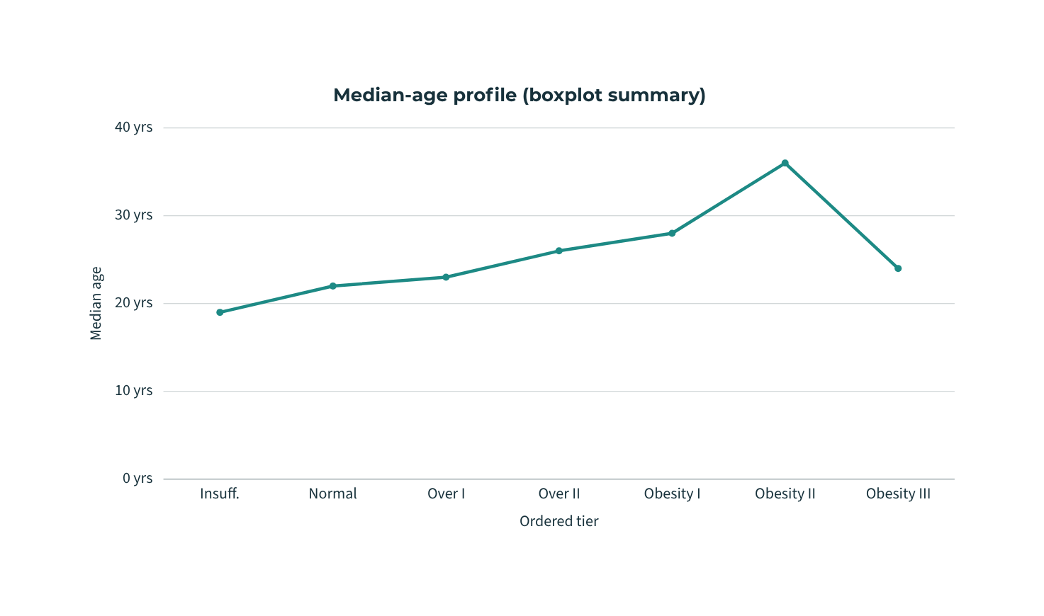
Age is strongly associated with weight tier
ANOVA
p < 0.001
Age distributions shift systematically across tiers—especially toward Obesity II. Association is strong, but non-monotonic.
OBESITY & LIFESTYLE EDA | FY.BCA.SEM1 (DIV-A) | MSU Vadodara
10/22

Slide 11
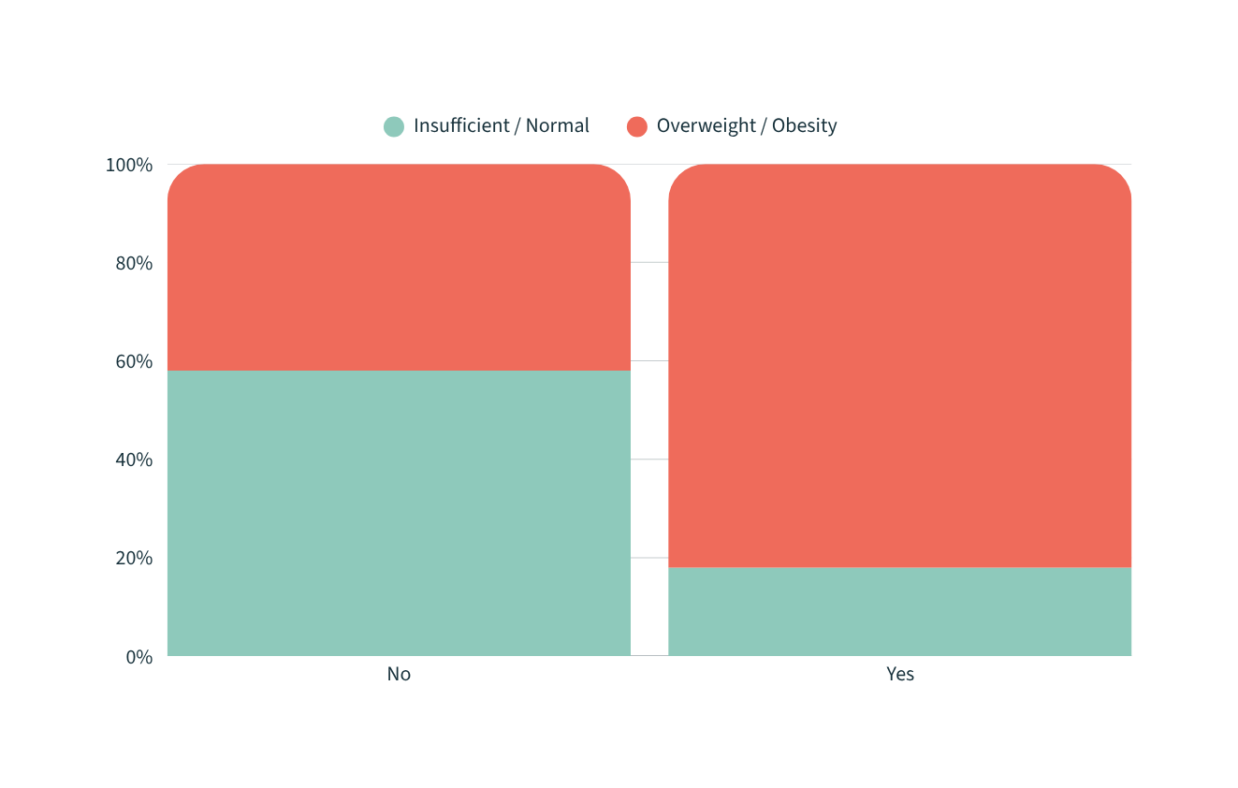
Family history: the genetic gatekeeper
χ² test
p < 0.001
Family history changes the baseline risk context for nearly every lifestyle variable.
CONDITION, DON’T COLLAPSE
OBESITY & LIFESTYLE EDA | FY.BCA.SEM1 (DIV-A) | MSU Vadodara
11/22

Slide 12
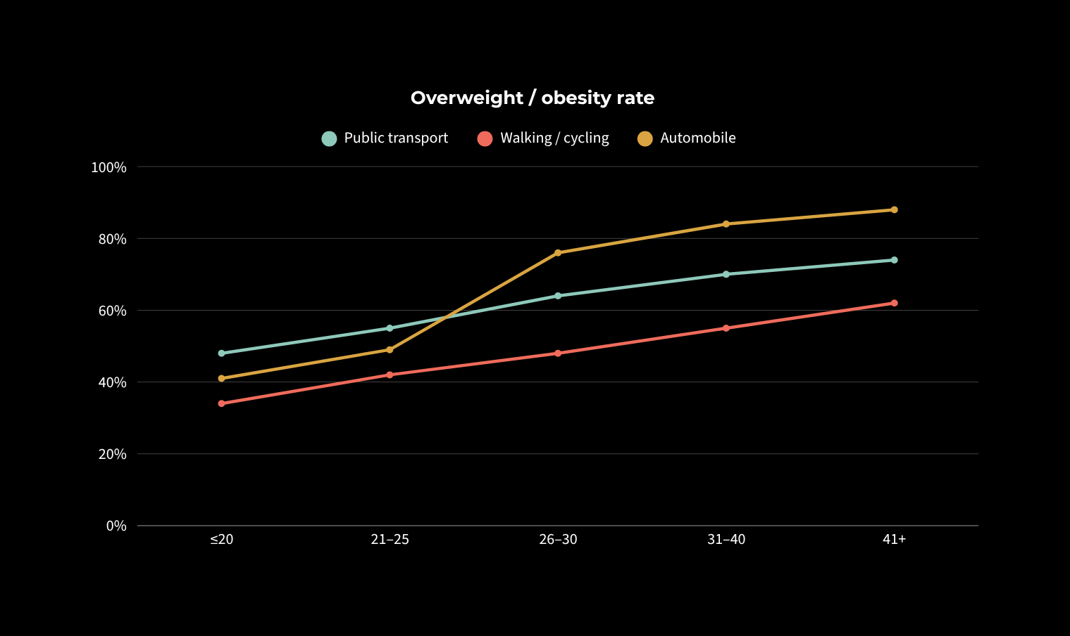
The commute × age interaction
+27 pp
automobile jump
after age 25
Commute mode becomes informative only when age is visible.
OBESITY & LIFESTYLE EDA | FY.BCA.SEM1 (DIV-A) | MSU Vadodara
12/22

Slide 13
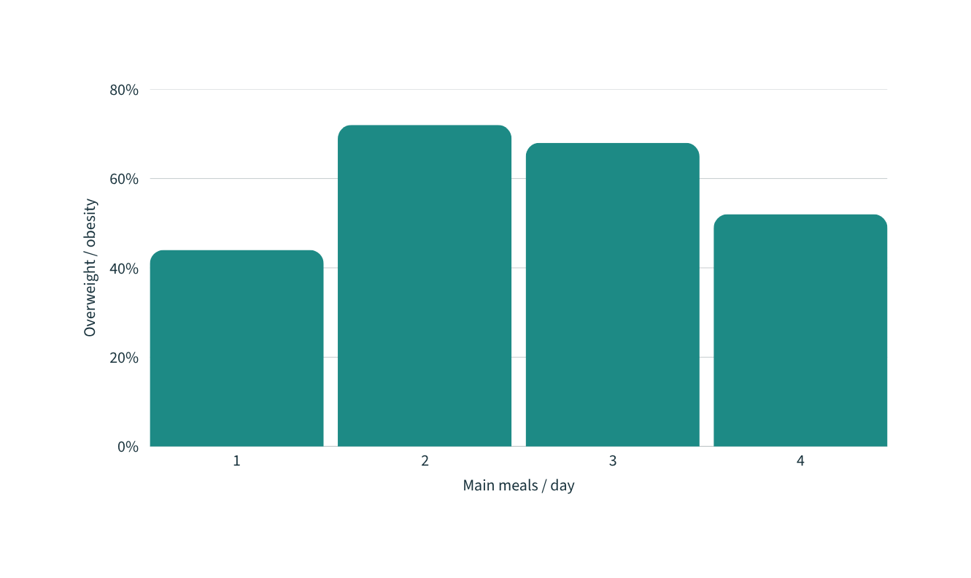
The meal-skipping paradox
≠
fewer meals
is not automatically
lower risk
Meal count is entangled with age, snacking, portions and routine. The raw pattern should not be read causally.
OBESITY & LIFESTYLE EDA | FY.BCA.SEM1 (DIV-A) | MSU Vadodara
13/22

Slide 14
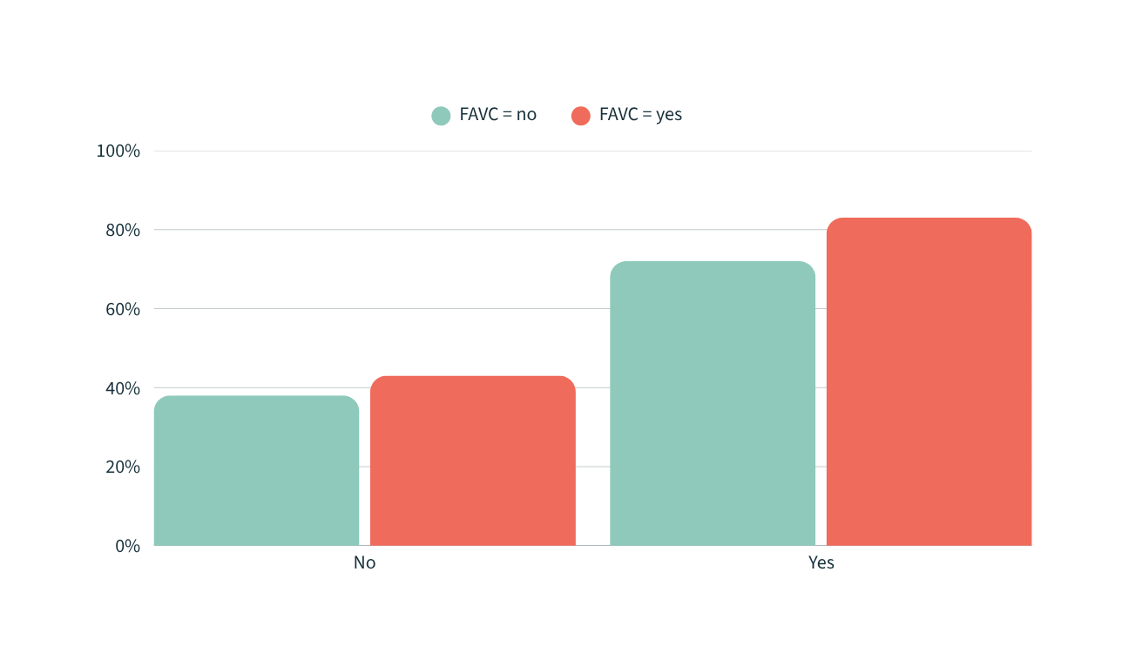
When a variable looks irrelevant: FAVC × family history
RAW VIEW
≈ 0
simple relationship
CONDITIONED VIEW
Signal emerges
within the family-history strata
OBESITY & LIFESTYLE EDA | FY.BCA.SEM1 (DIV-A) | MSU Vadodara
14/22

Slide 15
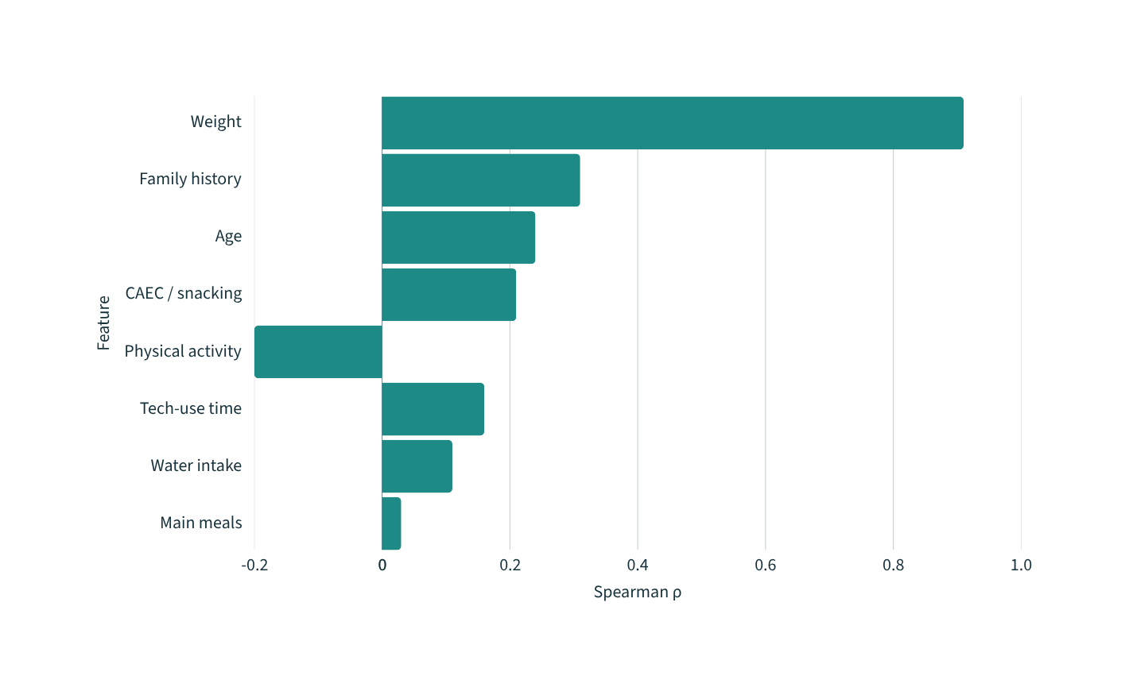
Correlation map: what matters most?
Ranking ≠ explanation
Weight is mechanically close to the target definition. Smaller marginal coefficients can still hide large conditional effects.
ρ shown against ordered NObeyesdad
OBESITY & LIFESTYLE EDA | FY.BCA.SEM1 (DIV-A) | MSU Vadodara
15/22

Slide 16
Grouping reveals structure
RAW ROWS
GROUP BY
AGGREGATE
COMPARE
INTERPRET
one person / row
class + behavior
count · mean · median
within / across groups
interaction clues
Grouping is not a conclusion. It is the bridge between individual records and testable comparisons.
OBESITY & LIFESTYLE EDA | FY.BCA.SEM1 (DIV-A) | MSU Vadodara
16/22

Slide 17
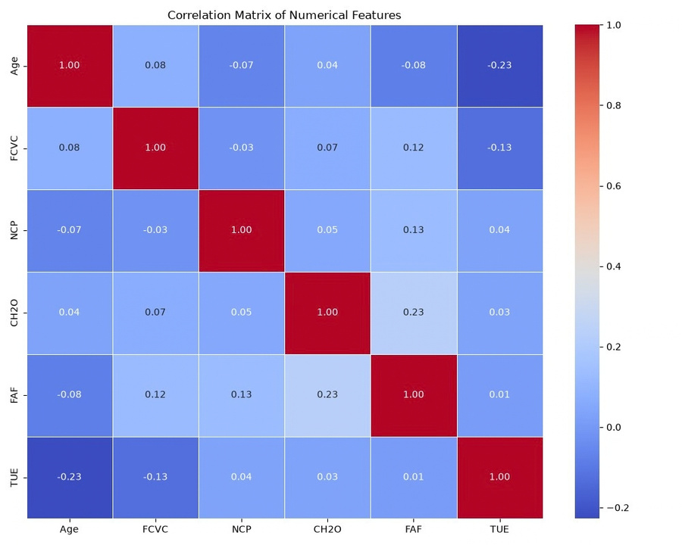
Correlation is a map—not a verdict
What it can tell us
Direction and strength of pairwise linear relationships; possible redundancy among numeric features.
What it cannot tell us
Causality, nonlinear structure, confounding, or the behavior of categorical variables without appropriate encoding.
HEATMAP PLACEHOLDER
OBESITY & LIFESTYLE EDA | FY.BCA.SEM1 (DIV-A) | MSU Vadodara
17/22

Slide 18
Why look beyond simple correlations?
Weight status is not a single-variable outcome.
CENTRAL IDEA
The objective is to map how behavioral, genetic and environmental signals combine—then carry those interactions into modeling.
GENETIC
family history
BEHAVIOR
food + activity
ENVIRONMENT
commute + context
WEIGHT STATUS
OBESITY & LIFESTYLE EDA | FY.BCA.SEM1 (DIV-A) | MSU Vadodara
18/22

Slide 19
One question → one visual form
DISTRIBUTION
CATEGORY
GROUP DIFFERENCE
histogram / density
count / proportion
box / violin
ASSOCIATION
COMPOSITION
AUDIT
scatter / heatmap
100% stacked bar
missingness / ranges
OBESITY & LIFESTYLE EDA | FY.BCA.SEM1 (DIV-A) | MSU Vadodara
19/22

Slide 20
Six findings that move the analysis forward
01
02
The outcome has seven distinct classes.
Age distributions vary across target groups.
03
04
Family history is an important comparison factor.
Lifestyle variables add behavioral context.
05
06
Class balance must shape evaluation choices.
EDA supports—not replaces—predictive validation.
OBESITY & LIFESTYLE EDA | FY.BCA.SEM1 (DIV-A) | MSU Vadodara
20/22

Slide 21
References
[1] UCI Machine Learning Repository - Estimation of obesity levels based on eating habits and physical condition
[2] Palechor, F. M. & de la Hoz Manotas, A. (2019). Dataset for estimation of obesity levels.
[3] Python, Pandas, NumPy, Plotnine and SciPy documentation — versions used in the analysis environment.
DESCRIPTIVE
RELATIONAL
PREDICTIVE
The cohort spans seven distinct weight tiers.
Age and family history reshape lifestyle signals.
Models should encode interactions and respect order.
OBESITY & LIFESTYLE EDA | FY.BCA.SEM1 (DIV-A) | MSU Vadodara
21/22

Slide 22
From notebook to evidence
github.com/<owner>/<obesity-lifestyle-eda>
/data
/notebooks
/figures
raw + cleaned inputs
EDA + validation steps
exported Plotnine charts
All Python code, Jupyter notebooks, and data cleaning scripts utilized for this analysis and the associated visualizations are version-controlled and hosted online.
OBESITY & LIFESTYLE EDA | FY.BCA.SEM1 (DIV-A) | MSU Vadodara
22/22

